Slide 1

Notes:
Hi, Myself Krishna. I work on data analysis projects. One such project is , AndhraPradesh’s Government recent launch of Service delivery to citizens via Whatsapp. It is named as “MANA MITRA”. In this video I am going to discuss about this new service delivery platform in detail

Slide 2
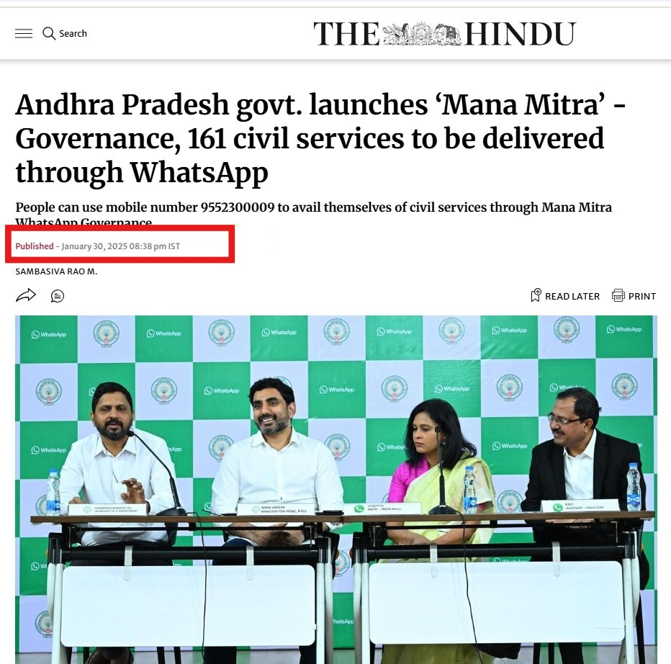
Notes:
AP State Govt has launched Citizen Services through “ManaMitra” from 1stFeb2025. As Part of this Program Govt initially rolled out 161 services via whatsapp and is planning to roll out 300+ services in near future. To avail service a citizen doesn’t need to install any app from Playstore or third party. The person need to save phone number “9552300009” in whatsapp and type “HI”

Slide 3
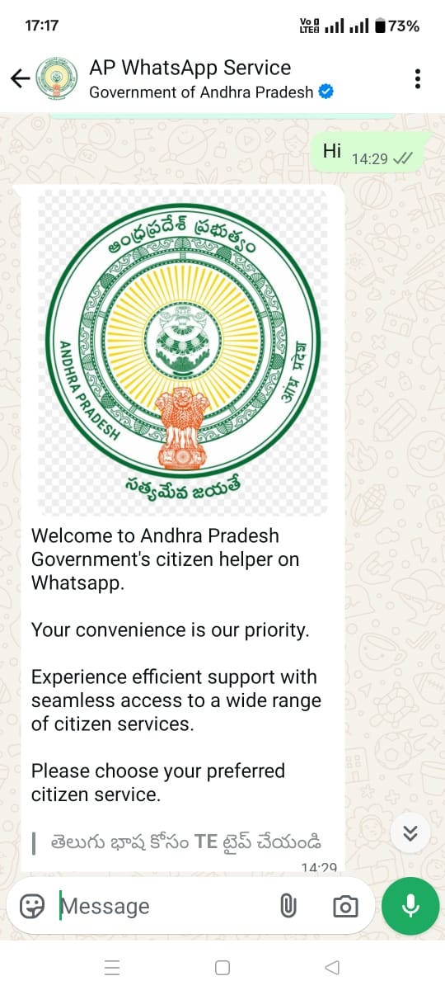
Service choosing option pop-up along with language preference
Notes:
After Hi, a reply from whatsapp mentioning the kind of service required for the citizen pops-up. For government to include most of its service in whatsapp a data analysis has to be done about Maximum number of service requests and Revenue Generation.

Slide 4
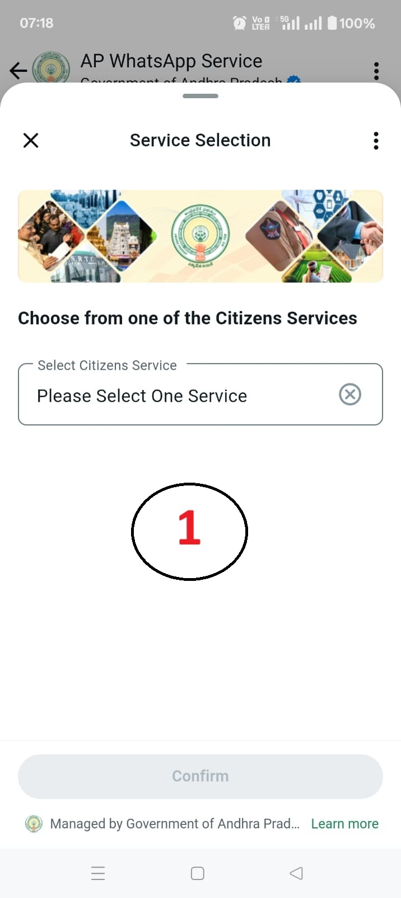
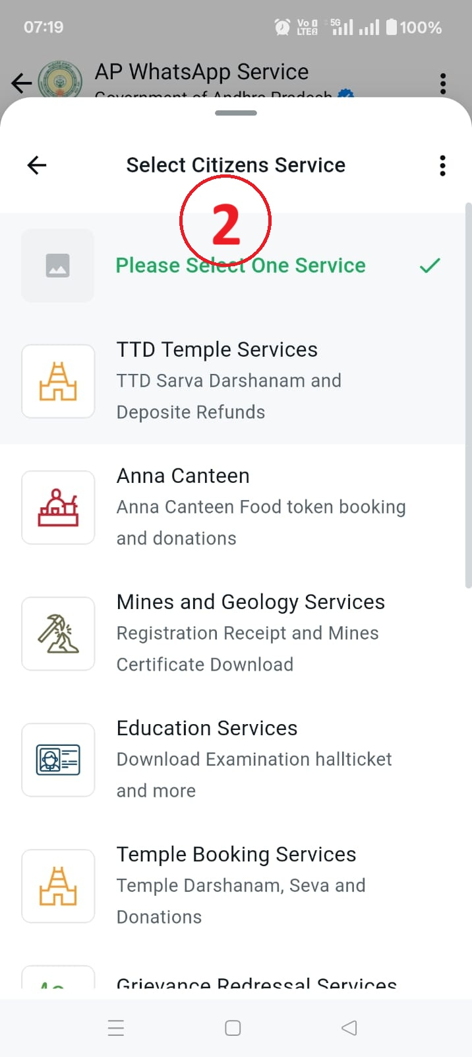
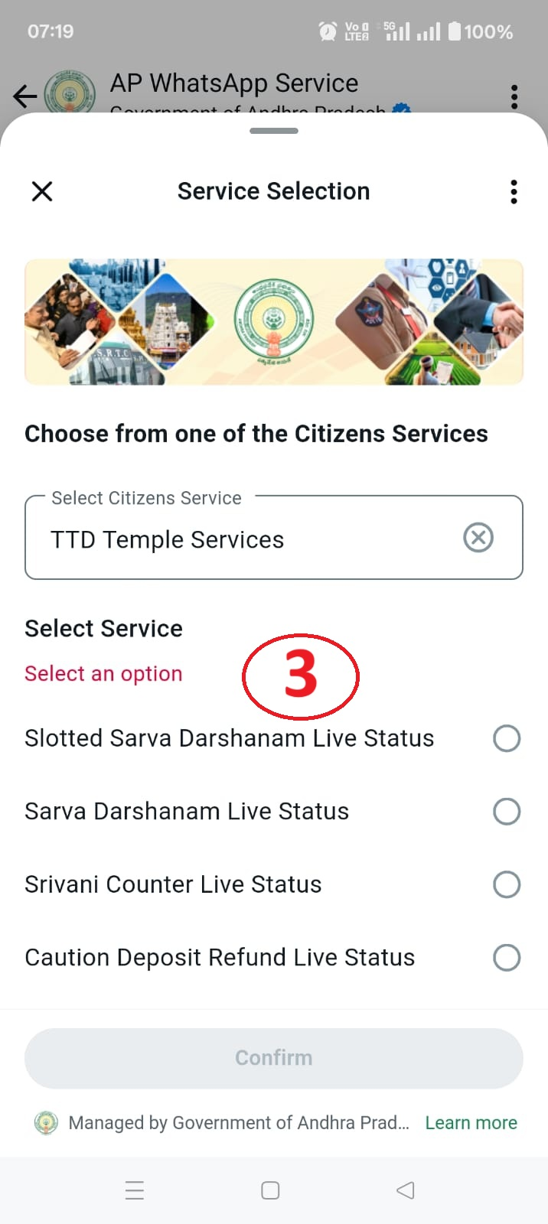
Notes:
Immediately after selection of language, selection of service pops-up
Different Departments currently available via whatsapp services displayed as a scroll-down menu
After selection of a particular department, total services available online in that departments gets dropped down.
Selection of service and submission with required prerequisite can be done by citizen itself

Slide 5
Whatsapp Services Roll out- KPI’s (Key Performance Indicators)
Total Service Requests
Total Revenue Generation from Service
Top 10 Departments_Service/Revenue based
Whatsapp –Roll out of Services
Inference of services data for Whatsapp based on current services portal
Notes:
The Most impotant part of the analysis is KPI’s. This slide discusses about what are we going to analyse in the coming slides.

Slide 6
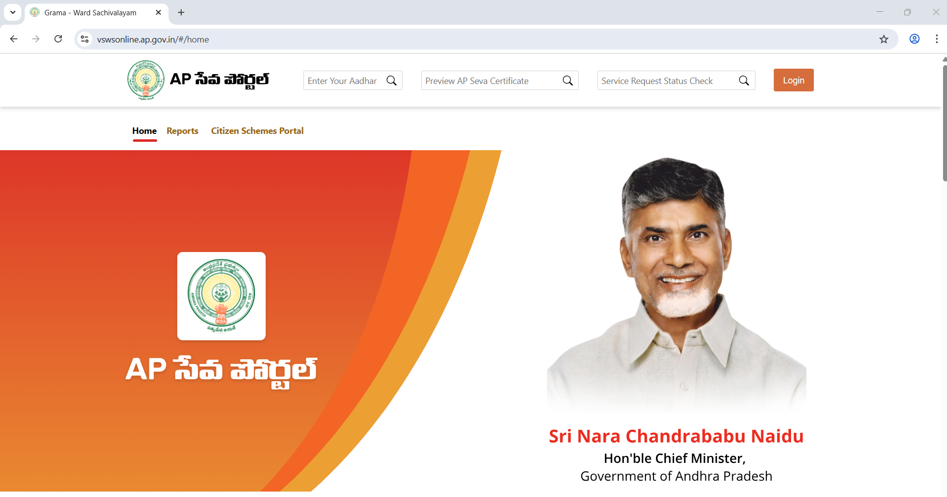
DATA SOURCE : vswsonline.ap.gov.in
Notes:
For Data Analysis, Data collected from Portal : vswsonline.ap.gov.in. The portal is used for service delivery from 3-4 years till date. Upgradation of services from AP Seva to Whatsapp is the main theme of this Project

Slide 7
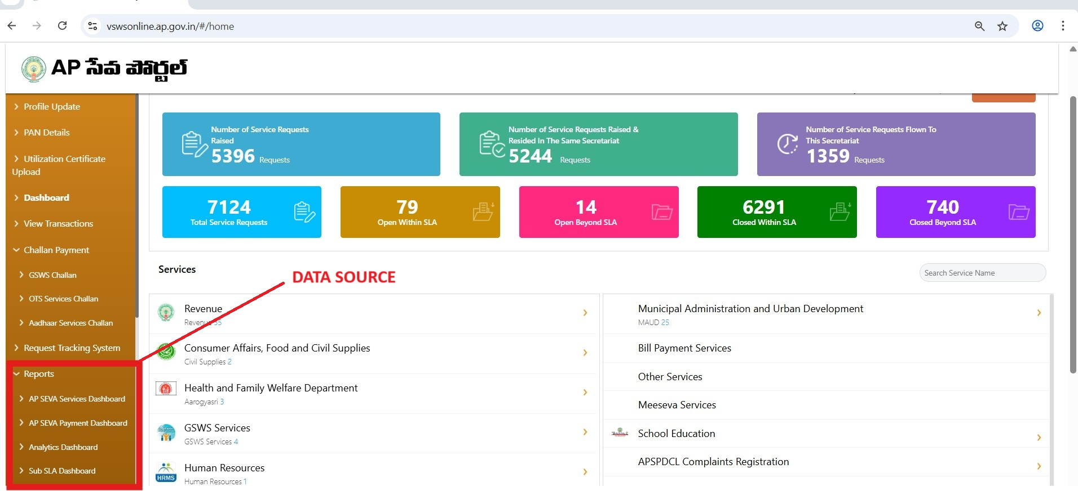
Notes:
As we can see here, there are different services delivered for different departments using portal. This is the data source for our current analysis. By collecting data from different Dashboards current analysis of citizen services in the period of Oct 2019 to march2025 done

Slide 8
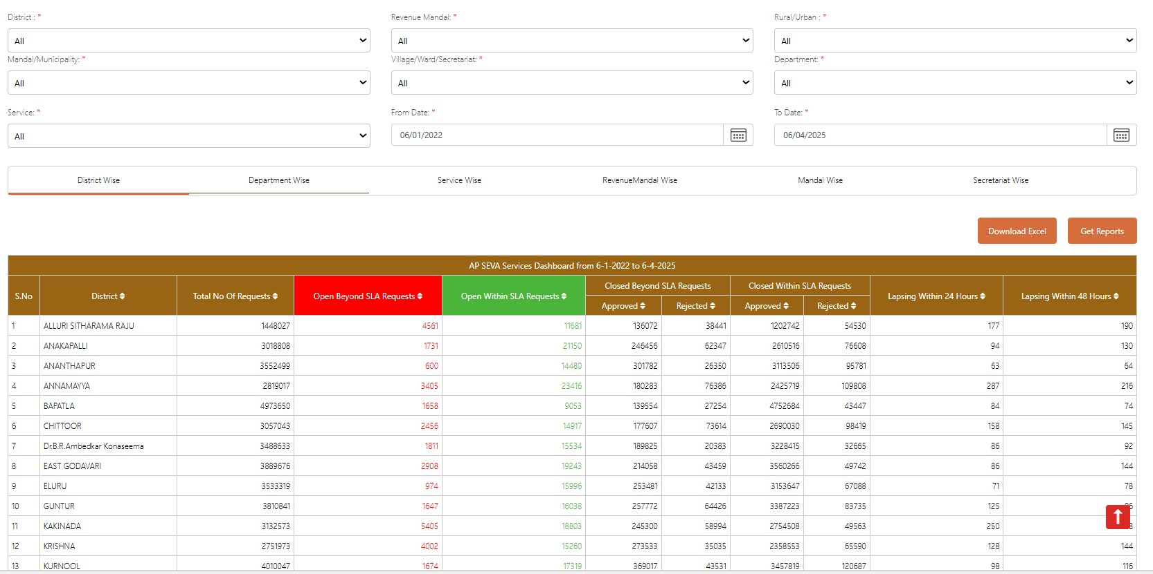
Notes:
Here we can see AP SEVA services dashboard and the total service requests raised from APSEVA inception

Slide 9
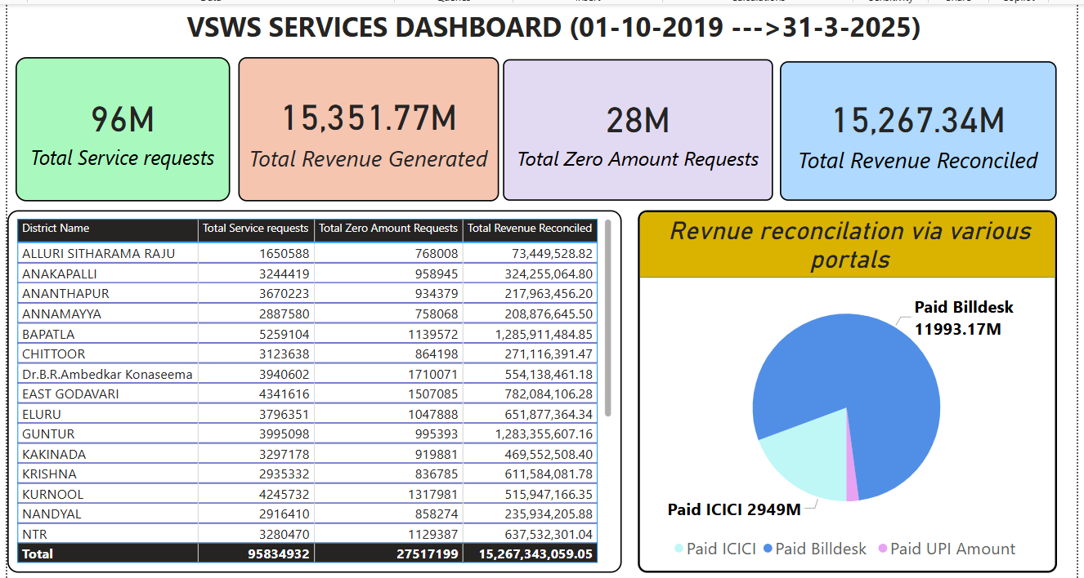
Notes:
Total Service requests generated using APSEVA Portal from different districts, Total Revenue generated with the service requests, Revenue reconciliation and zero amount service requests which implies free services ( eg: pensions, job enrollment,surakhsa token registrations)

Slide 10
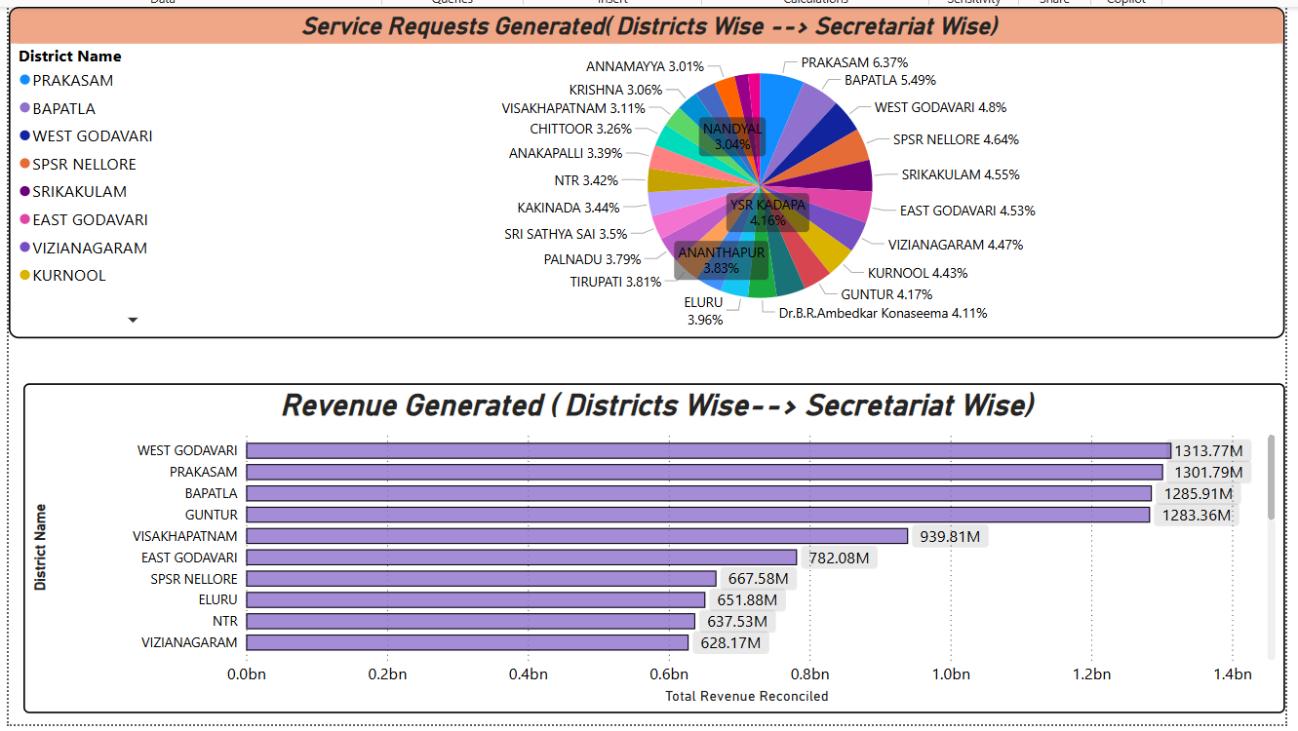
Notes:
The Present slide illustrates Districts with service requests and revenue generated. Here we can observe that, district with maximum no of services generated(Prakasam with 6.37% ) is not district with maximum revenue generation(West Godavari). Which implies that, Services generated is not directly proportional to Revenue Generation. This could be better understandable with comparisons. Let’s compare these in the coming slides

Slide 11
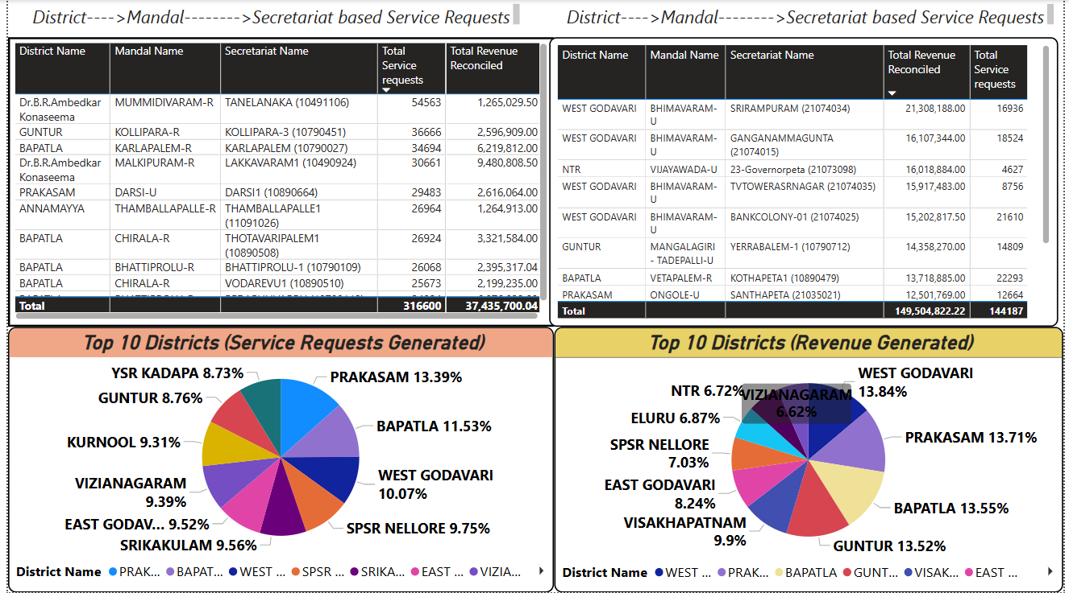
Notes:
In this slide, we can observe the Top 10 districts in terms of services as well as revenue generation.Although the secretariat topped in service generation (Dr.B.R.Ambedkar Konaseema, Mummidivaram-R, TANELANKA) with 54563 requests but the district is not in Top 10 of service generation. Gross average of all the secretariats reduced it’s merit. Similarly all the secretariats which topped in service requests didn’t top revenue generation and vice versa. This indicates concerntration of services with maximum revenue generation is the need of the hour.

Slide 12
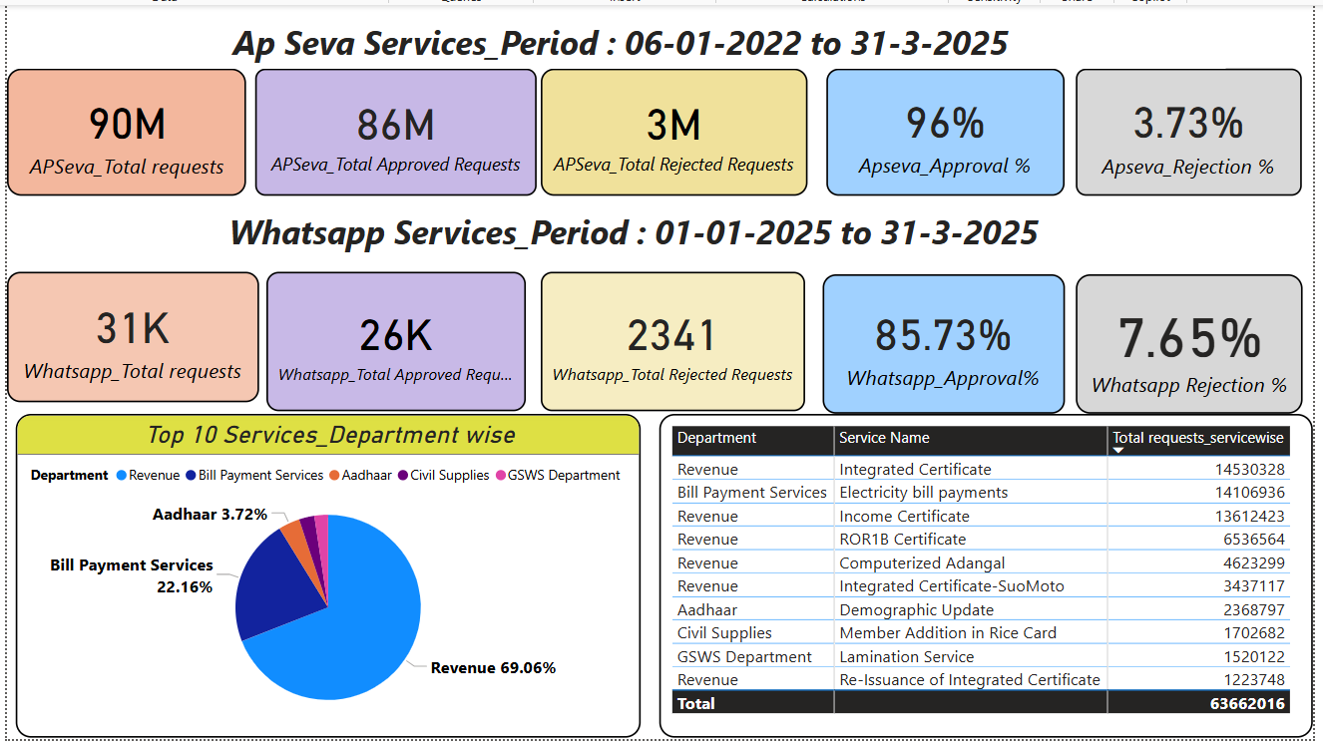
Notes:
Here we can see the service requests generation, approval and rejection ratio for AP Seva as well as Whatsapp services. Services applied via AP Seva has maximum approval ratio compared to services applied via whatsapp. The reason could be wrong uploading of documents in whatsapp services, uploading blurred documents, wrong format uploading and many other cases. It is observed that, Top 10 services comes under Revenue, Electricity bill payments, Civil Supplies and Aadhar. So, these are the areas to be concentrated in WhatsApp services

Slide 13
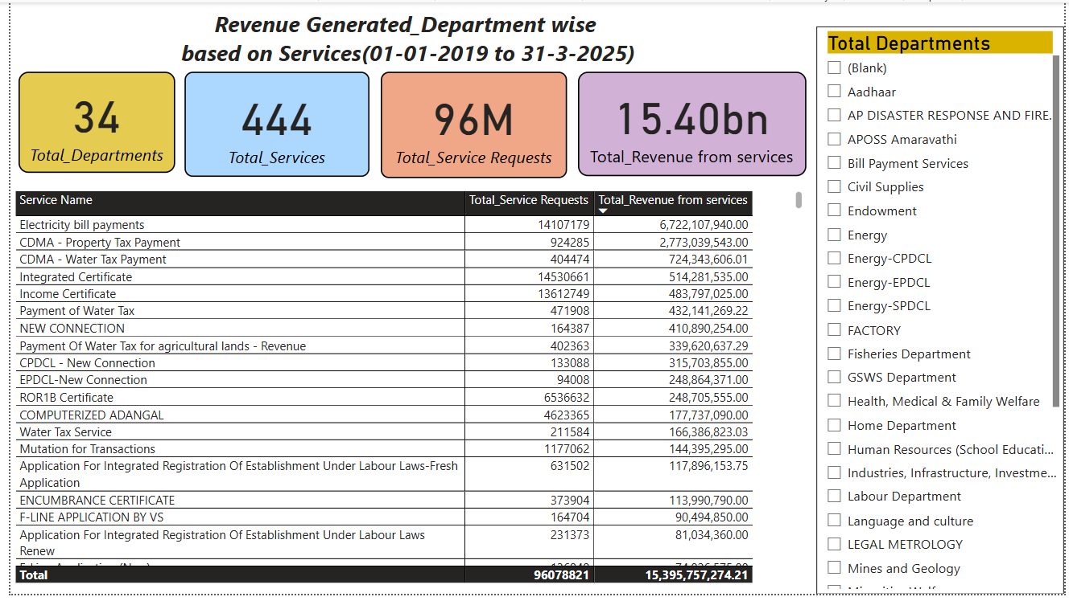
Notes:
Total number of Departments with online services are 34 and these 34 departments provide 444 services, out of which maximum number of 130+ services comes under revenue, followed by energy-49 , health medical and family welfare-15, civil supplies -10,registration and stamps-13, Fisheries-11, SERP-11, GSWS-7and number of departments

Slide 14
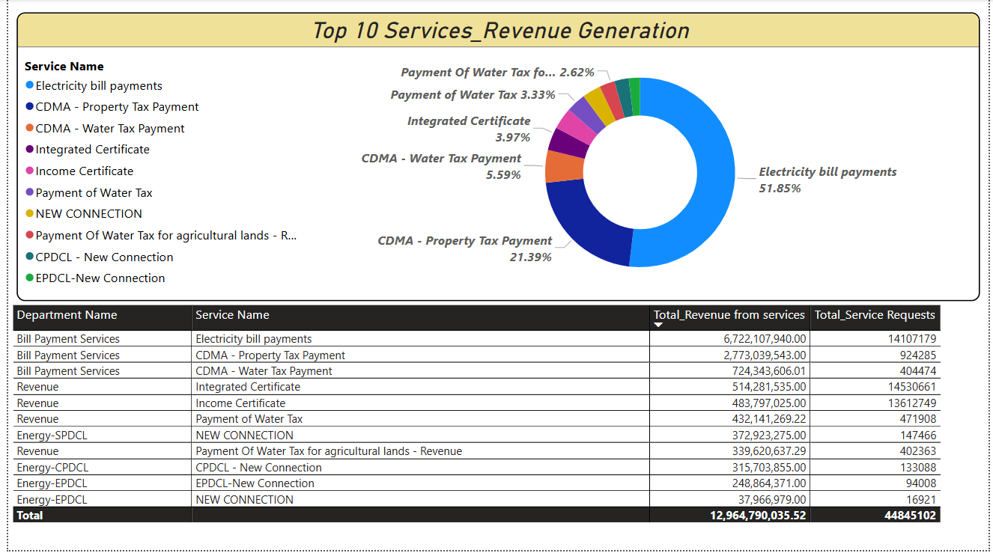
Notes:
Finally the services with maximum revenue generation are Electricity bill payments contributing to 50%, followed by tax payments and caste, income certificates, New energy meter connections. Mostly used are above 10 services. Therefore, It is recommended to compulsory add these services in whatsapp for successful adoption and penetration of whatsapp into the public

Slide 15
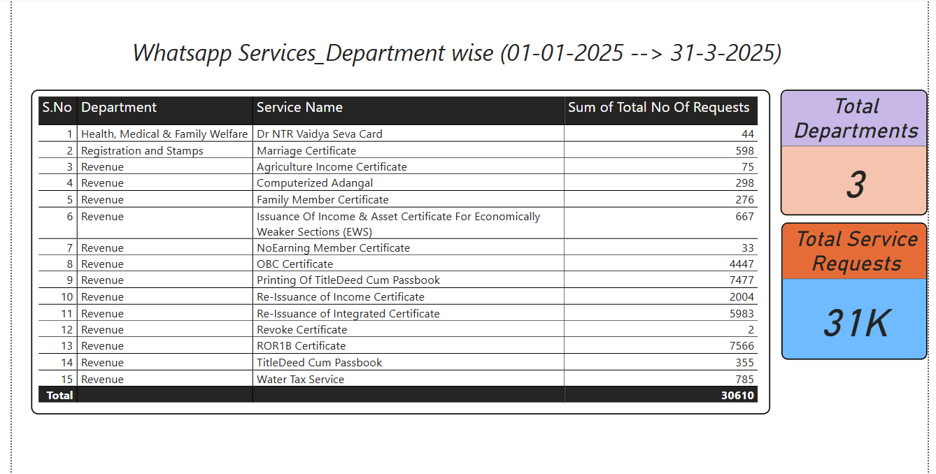
Notes:
Since its roll out , citizen started using for variety of services but mostly used services of whatsapp in AP State are ..For successful adoption of whatsapp as a service platform to public the services which are mostly useful by them on daily basis should be made available in easy and hassle free manner for citizen to use it

Slide 16
Inferences
Category –A Services (Bill payments, tax payment and 15minutes delivery services) topped in revenue generation
Revenue services, ENERGY Services topped in Category –B
For success in Whatsapp services in terms of Revenue as well as in Services Generation, it is recommended to bring Maximum Number of services under Category –A
To reduce Rejection ratio of Service, prerequisites required for the service should be mentioned before service initiation as well as integration of Aadhar, Digi-Wallet Id’s to services for citizens make smooth functioning of services

Slide 17
Inferences
Publicity based on Target Audiences by utilizing previous services data. i.e., Services which are mostly used by Students are Integrated certificate, Income certificate, OBC Certificate etc., Revenue services related to students must be integrated in Whattsapp in Category-A and should be charged only Service charges when provided with student id
Rice card services are mostly used. Elimination of e-kyc’s makes public more user friendly approach
Providing SOP’s or creation of Free YouTube channel videos regarding particular service, it’s uses, Documents required before applying and how to apply, steps to be taken after applying,How to know the status of application. All these should be made and upload in Youtube service wise,so that beneficiary may not confuse with Technical Revenue Jargon

